Slide 1

Song Genres Analysis NLP and Clustering Approach Metis Individual Project 4 Shuo Jia

Slide 2



Data Source:
Billboard Top 100 Songs 1950 – 2015
Spotify API
Data Description:
Lyrics Related: lyrics, sentiment index, complexity of lyrics
Music Related: danceability, energy, key, tempo, acousticness
Analysis Objective:
NLP and topic modeling on lyrics
Unsupervised learning on all features
Potentially build recommendation system

Slide 3







Methodology
NLP Text Preprocessing
Clustering
Tokenize
Text Cleansing
Bigrams
Remove Stopwords
Lemmanization
K Means
DBSCAN
PCA 3D Visualization
LDA Gensim
Visualization pyLDAvis
Model Evaluation
Topic Space Mapping
Recommendation
Topic Modeling
Future Work

Slide 4
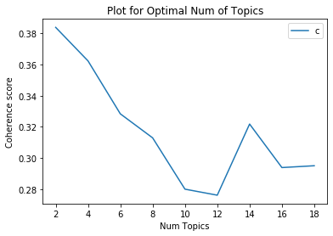
Topic Modeling - LDA
Find Optimal Number of Topics
Coherence Score - Assessing The Quality of Learned Topics
Best Number of Topics - 8
Topic 1: Life
Topic 2: Romance
Topic 3: Party
Topic 4: Family | Happiness
Topic 5: Sexual Oriented
Topic 6: Clubbing
Topic 7: Sadness
Topic 8: Violence

Slide 5
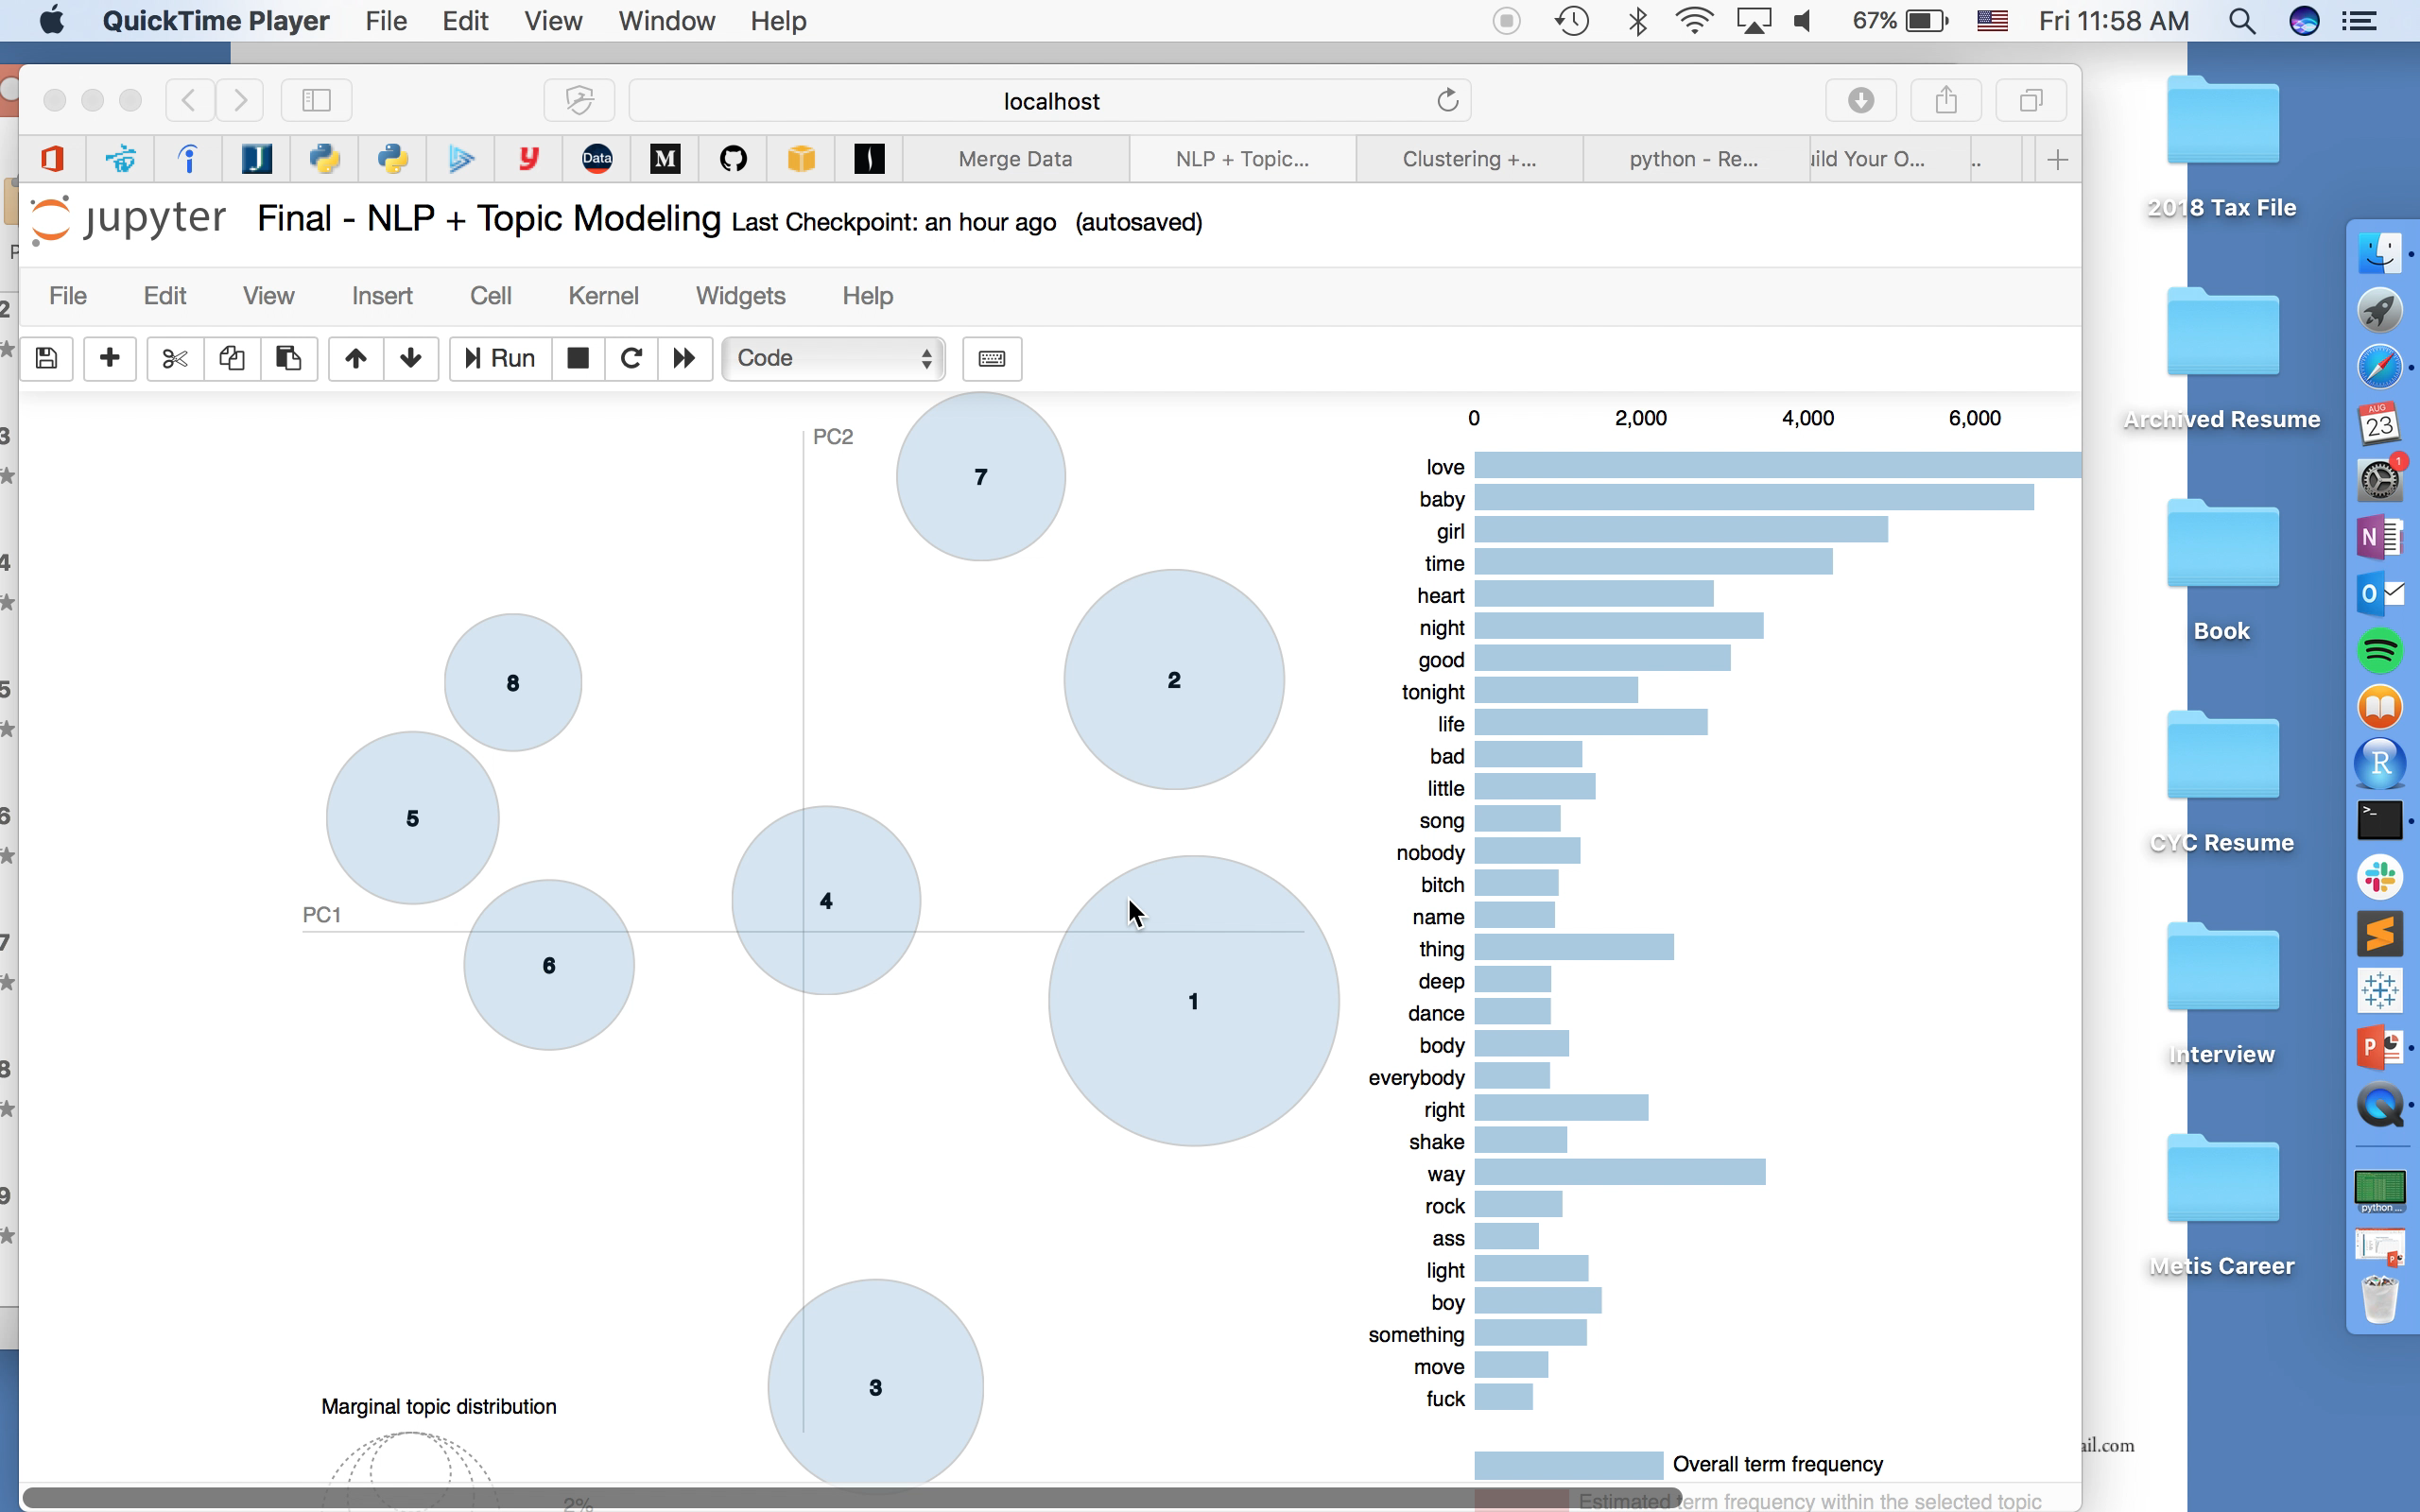

Slide 6
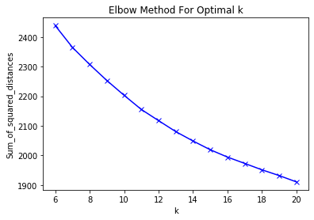
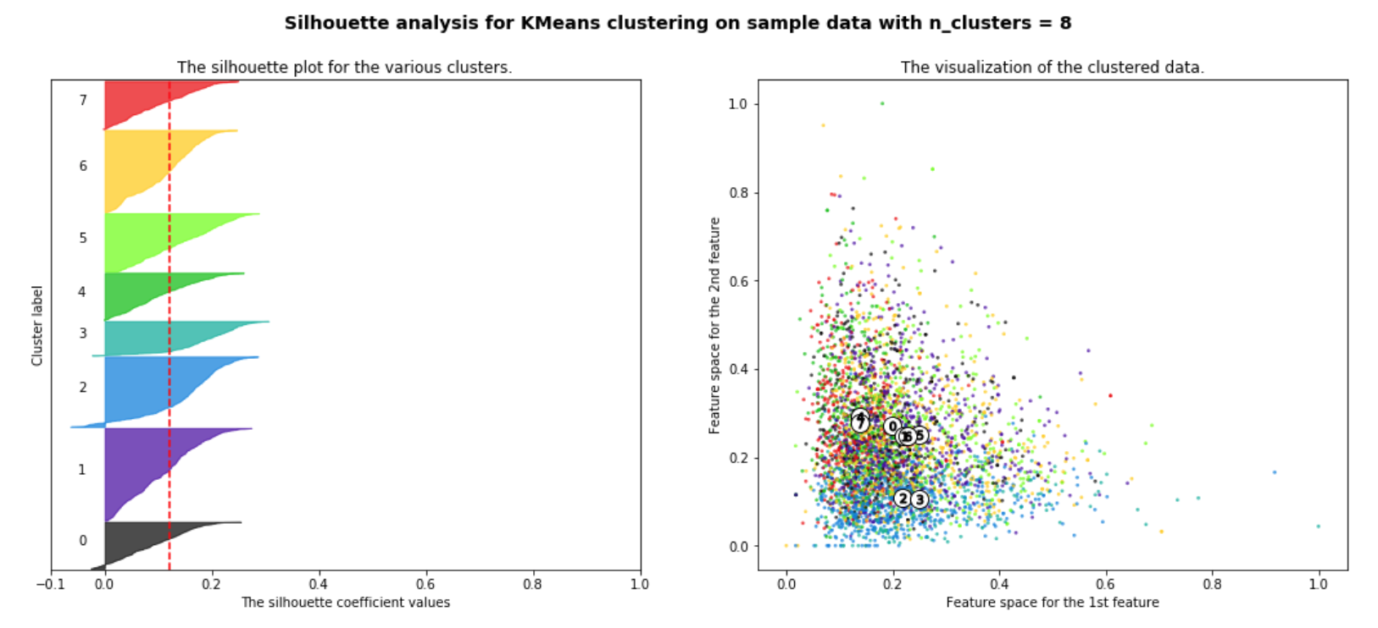
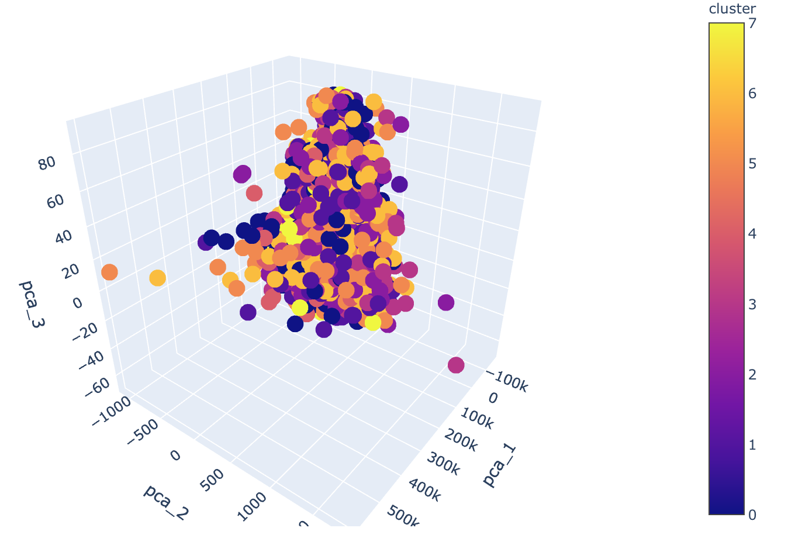
Clustering – K Means
Find Optimal Number of Clusters:
Elbow Plot – Inertia
Average Silhouette Score (0.13)
PCA 3D Visualization

Slide 7
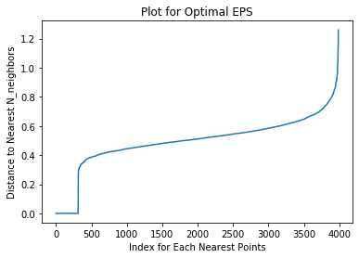
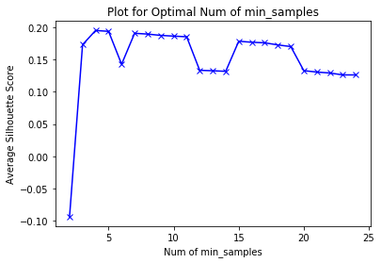
Clustering – DBSCAN (Euclidean)
Find Optimal Epsilon (0.7)
N Nearest Neighbors
Find Optimal Min_samples (5)
Silhouette score
Results
Silhoutte Score: 0.194
N_clusters_dbscan = 2

Slide 8
Clustering Results

Slide 9
Future Improvements
Map the Clusters to Genres
Apply PCA Dimension Deduction before Clustering
Feature Processing/ Selection
Build on Recommendation Based on Clustering Results

Slide 10

Thanks!
ANY QUESTIONS?

